Slide 1

Online Summer Training Course on Application Development in JAVA
Submitted by Adarsh
Registration No: 12211442
By Lovely Professional University, Phagwara

Slide 2

Introduction to Java
Introduction to Java
Overview of Java as a programming language
Importance of Java in application development
Cross-platform capability (WORA - Write Once, Run Anywhere)
Key features: Object-oriented, platform-independent, multithreaded, secure, etc.

Slide 3

Types of Applications in Java
Desktop Applications (Swing, JavaFX)
Web Applications (Servlets, JSP, Spring)
Mobile Applications (Android Development)
Enterprise Applications (Java EE, Spring Framework)

Slide 4

Java Development Tools
Integrated Development Environments (IDEs)
Eclipse
IntelliJ IDEA
NetBeans
Build Tools
Maven
Gradle
Version Control
Git and GitHub

Slide 5

Java Application Architecture
Layers of a typical Java application:Presentation Layer (Front-end technologies: JavaFX, JSP, Spring MVC)
Business Logic Layer (Services, Spring, EJBs)
Data Access Layer (JPA, Hibernate)
Database Layer (MySQL, PostgreSQL, Oracle, etc.)

Slide 6

Key Components of Java Development
JDK (Java Development Kit): Tools for writing, compiling, and running Java code.
JVM (Java Virtual Machine): Executes the compiled bytecode.
JRE (Java Runtime Environment): Provides libraries and JVM for running Java applications.

Slide 7
Frameworks for Java Development
Spring Framework: Inversion of control, dependency injection, MVC architecture.
Hibernate: ORM tool for database interactions.
JavaServer Faces (JSF): UI framework for web applications.
Struts: MVC-based web application framework.

Slide 8
Java Design Patterns
Creational Patterns: Singleton, Factory, Builder.
Structural Patterns: Adapter, Decorator, Proxy.
Behavioral Patterns: Observer, Strategy, Command.

Slide 9
Common Challenges in Java Application Development
Memory management (Garbage Collection)
Multi-threading and concurrency issues
Managing external libraries and dependencies
Performance tuning and optimization

Slide 10
Best Practices in Java Development
Writing clean, readable code (SOLID principles)
Testing: Unit Testing (JUnit, Mockito), Integration Testing
Security: Securing data, authentication, encryption
Performance: Profiling, caching, and memory management techniques

Slide 11
Future Trends in Java Application Development
Microservices Architecture: Spring Boot, Docker, Kubernetes.
Cloud Integration: Deploying Java applications in AWS, Azure, and GCP.
Reactive Programming: Handling asynchronous streams (Reactor, RxJava).
AI/ML with Java: Libraries like Deeplearning4j for building AI applications.

Slide 12

Project Overview
Purpose: A basic calculator that performs arithmetic operations such as addition, subtraction, multiplication, and division.
Tools: Developed using Java Swing for the graphical user interface (GUI).
Features:
Basic arithmetic operations.
User-friendly interface.

Slide 13
Technologies Used
Java: The main programming language used.
Swing: Java’s GUI toolkit to create windows, buttons, and input fields.
JDK: Java Development Kit for compiling and running the application.

Slide 14
Application Architecture
Front-end (GUI): Built using Java Swing components such as JFrame, JButton, and JTextField.
Back-end (Logic): Handles user input and performs arithmetic calculations.
Event Handling: Listens to button clicks to trigger appropriate actions (using ActionListener).

Slide 15
Key Components of the Code
Main Frame (JFrame): The main window where the calculator is displayed.
Text Field (JTextField): Used for input and output display of numbers.
Buttons (JButton): Number buttons (0-9) and operator buttons (+, -, *, /).
Action Listener (ActionListener): Captures button presses and performs actions.

Slide 16
Conclusion
Recap of Java's role in application development
Highlight its versatility across different types of applications
Future potential and importance in modern development

Slide 17
User Interface
Grid Layout: The calculator uses a 4x4 grid layout for buttons (numbers and operations).
Real-time Input Display: As the user presses buttons, the input is displayed in the text field.
Simple, Intuitive Design: Easily navigable for performing basic operations.

Slide 18
Arithmetic Operations
Supported Operations:
Addition
Subtraction
Multiplication
Division
Flow:
User enters the first number.
Selects the operator.
Enters the second number.
Presses = to view the result.

Slide 19
Code Workflow
Action Capture: Button clicks trigger the ActionListener.
Input Handling: Numbers are captured and displayed in the text field.
Operator Logic: The operator is stored when pressed.
Calculation: When = is pressed, the second number is processed, and the result is displayed.

Slide 20
Future Enhancements
Add more complex operations (e.g., square root, percentage).
Implement keyboard input support.
Add memory functions (M+, M-, MR).
Improve UI with better styling.

Slide 21
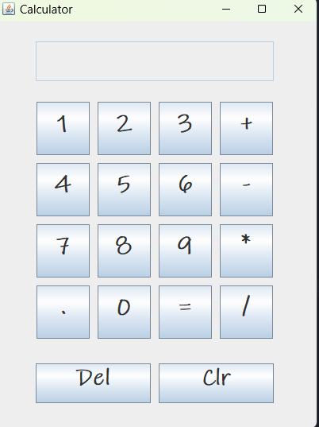
Thank you

